Slide 1
Setting up the ibm Cloud static web app

Slide 2
Create a bucket
Setting public access
Upload content to your bucket
Configure the options for your website
Testing and visiting your new Website
Static site generator using jekyll
Getting started
Diving in
conclusion

Slide 3
Before you start
Ensure that you have what you need to start:
An account for the IBM Cloud Platform
An instance of IBM Cloud Object Storage
Content in fixed form, like text (HTML would be perfect), and image files

Slide 4
Create a bucket configured for public access
Creating a bucket for a static website will require public access. There are a number of options for configuring public access. Specifically, using the ObjectReader IAM role will prevent the listing of the contents of the bucket while still allowing for the static content to be viewed on the internet. If you want to allow the viewing of the listing of the contents, use the ContentReader IAM role for your bucket.

Slide 5
Create a bucket
Once you login to the Console and after you create an instance of IBM Cloud Object Storage, you can create a bucket. Click on the button labeled “Create bucket” and choose from the options as shown in Figure 1. Select the card that reads “Customize your bucket

Slide 6
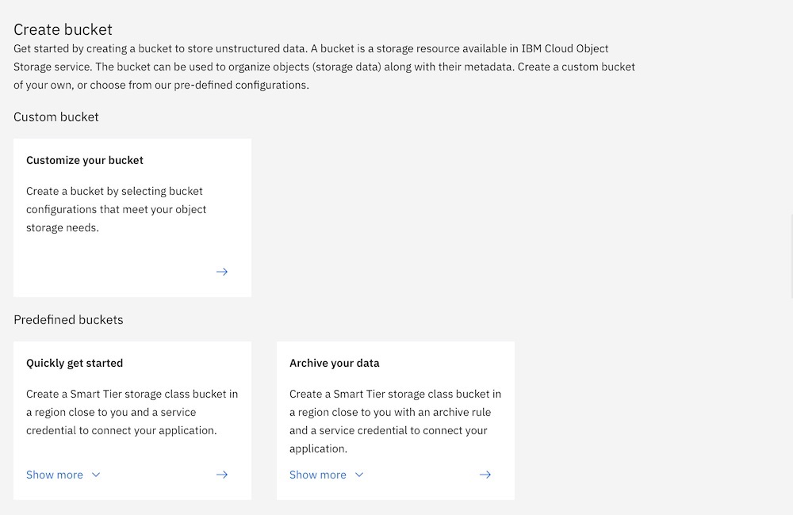

Slide 7
The container for the static files in your website will reside in a bucket that you can name.
The name you create must be unique, should not contain personal or identifying information, can’t have two periods, dots, or hyphens in a row, and must start and end with alphanumeric characters (ASCII character set items 3–63).

Slide 8
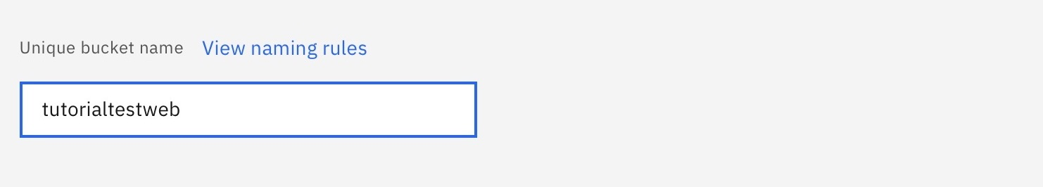

Slide 9
Setting Public access
In all scenarios for this tutorial, you will want to use the UI at the Console to allow public access to your new website.
When creating a bucket for hosting Static Website content, there is an option to enable public access as part of the bucket creation process
For the explanation of the options for the “index document” and “error document” as shown, find more below in the section Configure the options for your website.

Slide 10
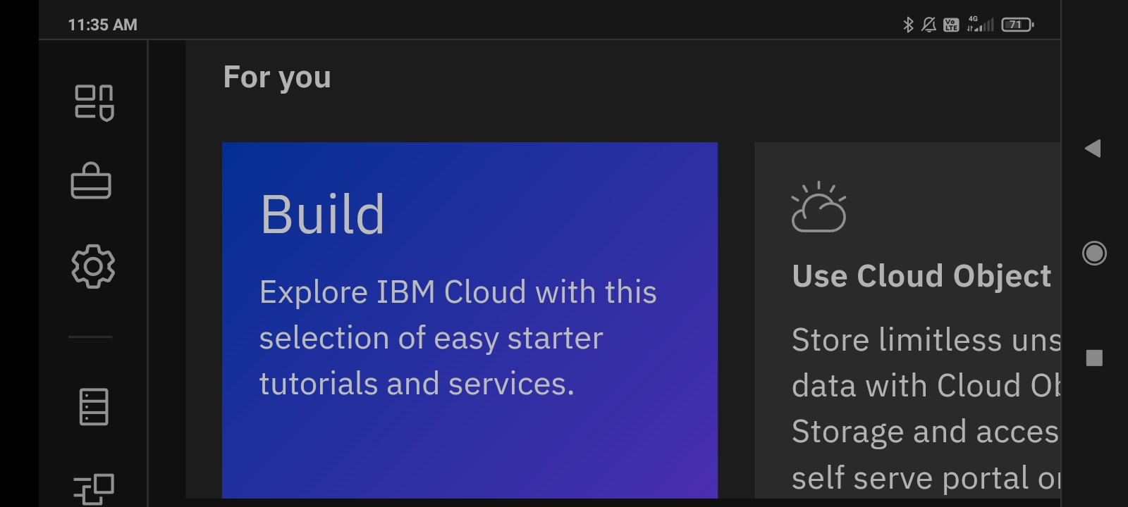

Slide 11
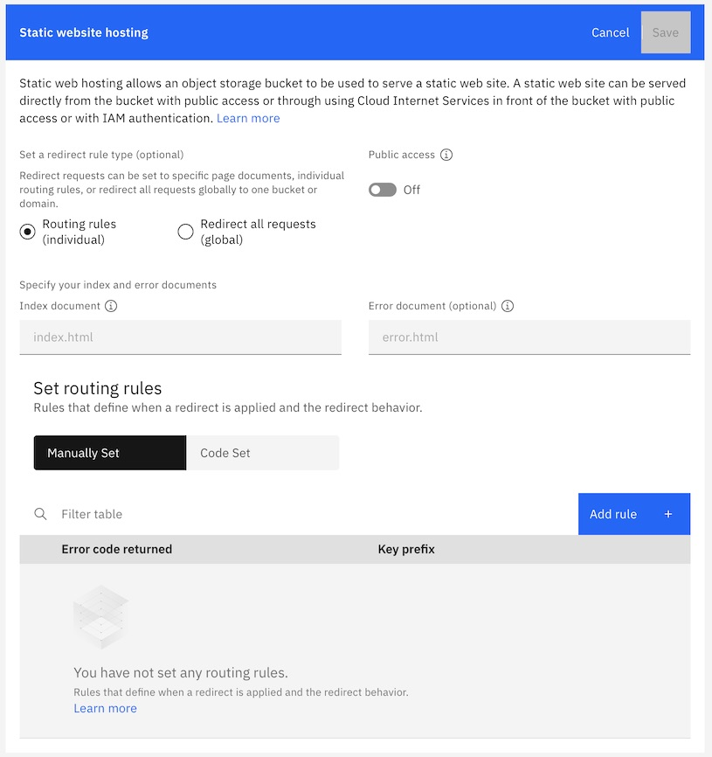

Slide 12
Upload Content to your bucket
The content of your hosted static website files focuses naturally on information and media. A popular approach to creating content for static websites are open source generators listed at StaticGen. For the purpose of this tutorial, we only need two files:

Slide 13
An index page, typically written in HTML and named index.html, that loads by default for visitors to your site An error page, also in HTML and here named error.html; typically the error page is loaded when a visitor tries to access an object that isn’t present or doesn’t have public access

Slide 14
Other files, like images, PDFs, or videos, can also be uploaded to your bucket
Files can be uploaded directly in the Console once you’ve named and configured your bucket.

Slide 15
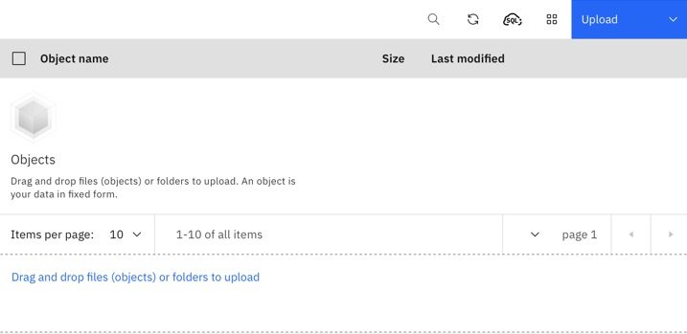

Slide 16
Configure the options for Your website
There are more options than this tutorial can describe, and for the purpose of this tutorial we only need to set the configuration to start using the static website feature

Slide 17
{ “ErrorDocument”: { “Key”: “error.html” }, “IndexDocument”: { “Suffix”: “index.html” } }

Slide 19
Testing and visiting your new website
Once you have configured your bucket to provide HTTP headers using the example command, all you have to do to test your new site is visit the URL for the site. Please note the protocol shown (http), after replacing the placeholders with your own choices made previously in this tutorial:

Slide 20
http://<bucketname>.s3-web.<endpoint>

Slide 21
Static site generator using jekyll
Jekyll is a simple, blog-aware, static site generator perfect for personal, project, or organization sites. Think of it like a file-based CMS, without all the complexity. Jekyll takes your content, renders Markdown and Liquid templates, and spits out a complete, static website ready to be served by Apache, Nginx or another web server. Jekyll is the engine behind GitHub Pages, which you can use to host sites right from your GitHub repositories.

Slide 22
https://jekyllrb.com/travelblog

Slide 23
Getting Started
Install the gem Read up about its Usage and Configuration Take a gander at some existing Sites Fork and Contribute your own modifications Have questions? Check out our official forum community Jekyll Talk and #jekyll Channel on Libera IRC

Slide 24
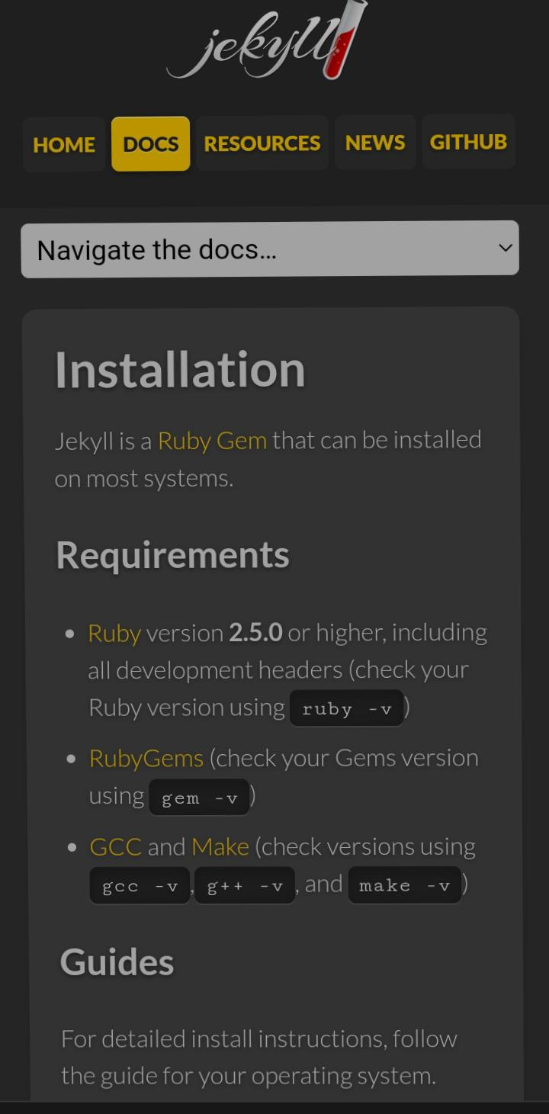

Slide 25
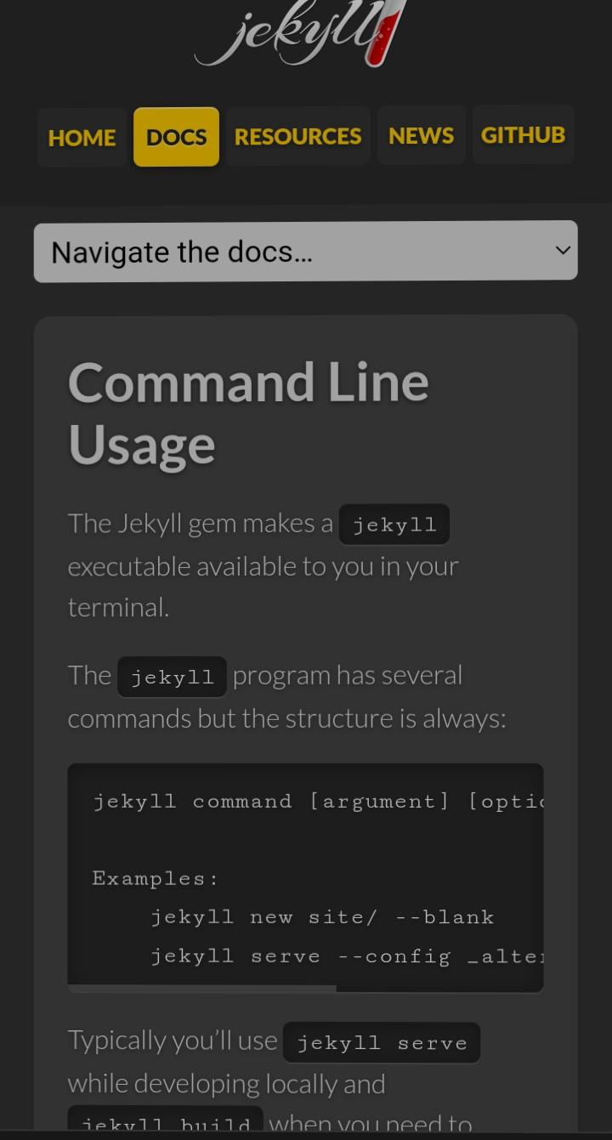

Slide 26
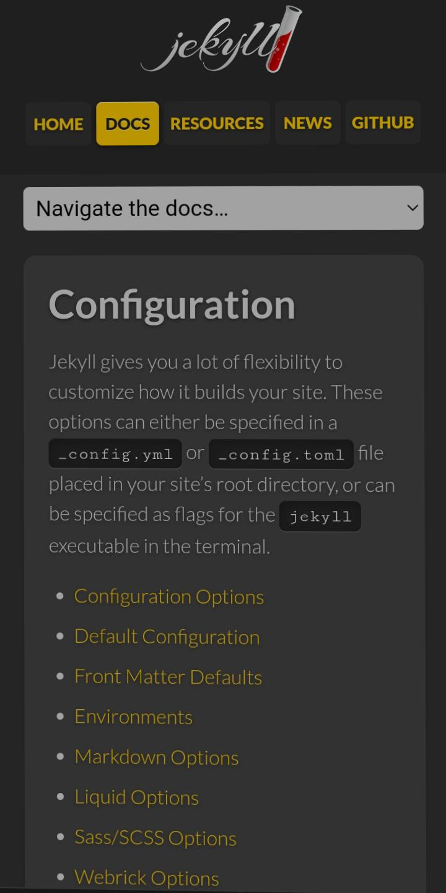

Slide 27
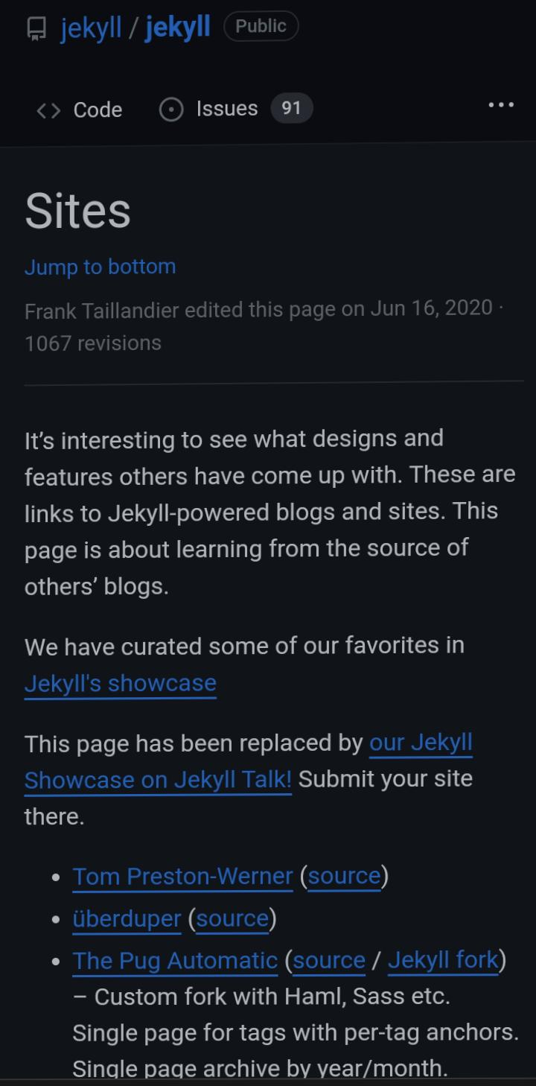

Slide 28
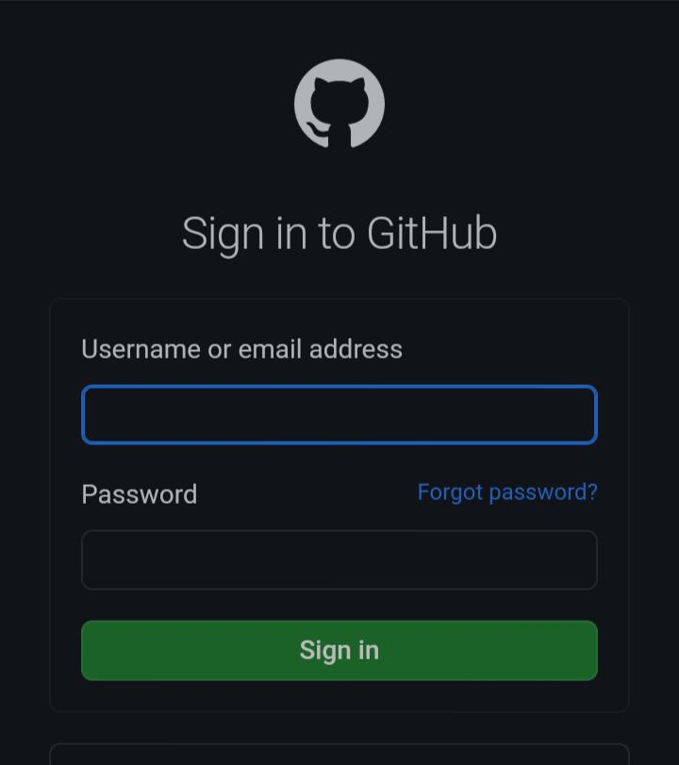

Slide 29
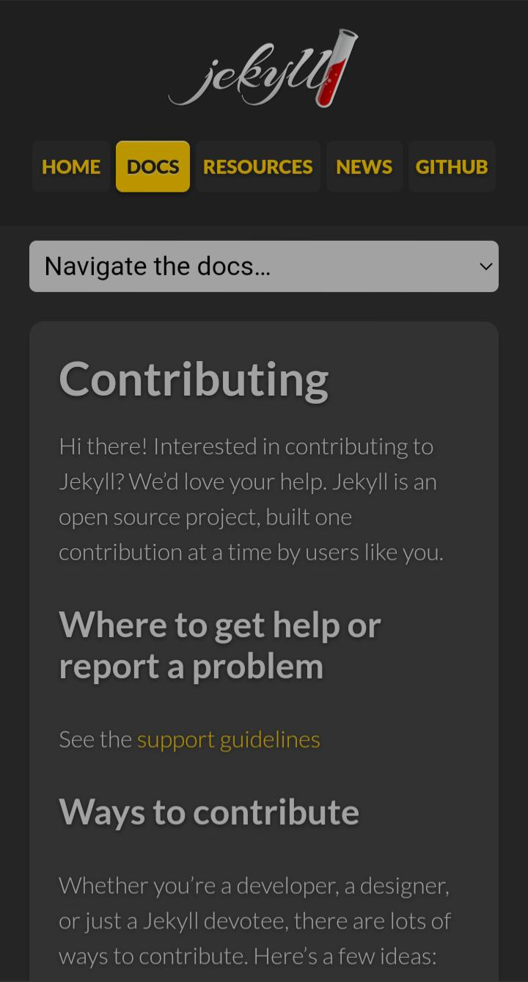

Slide 30
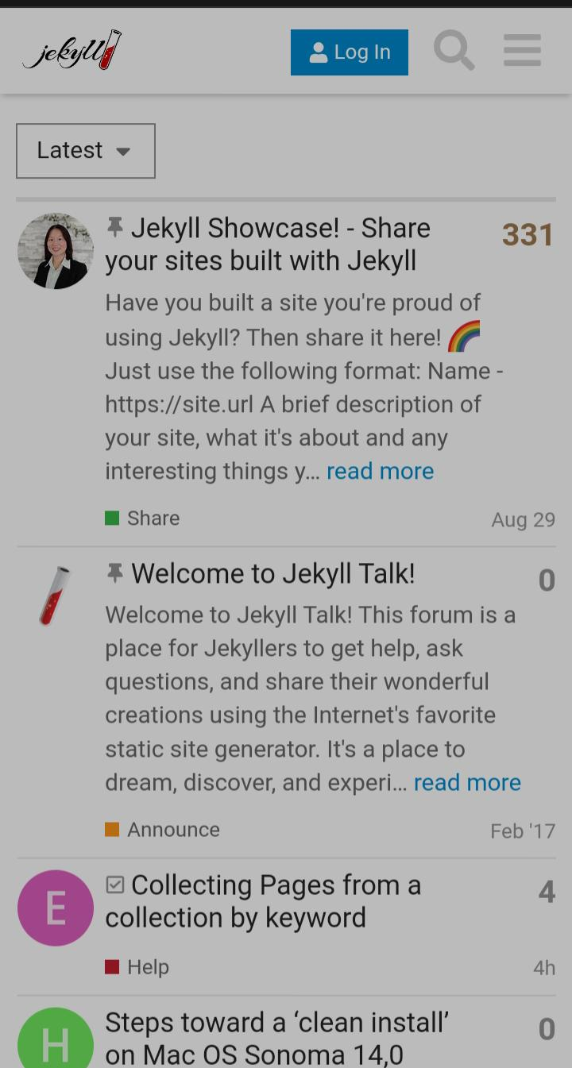

Slide 31
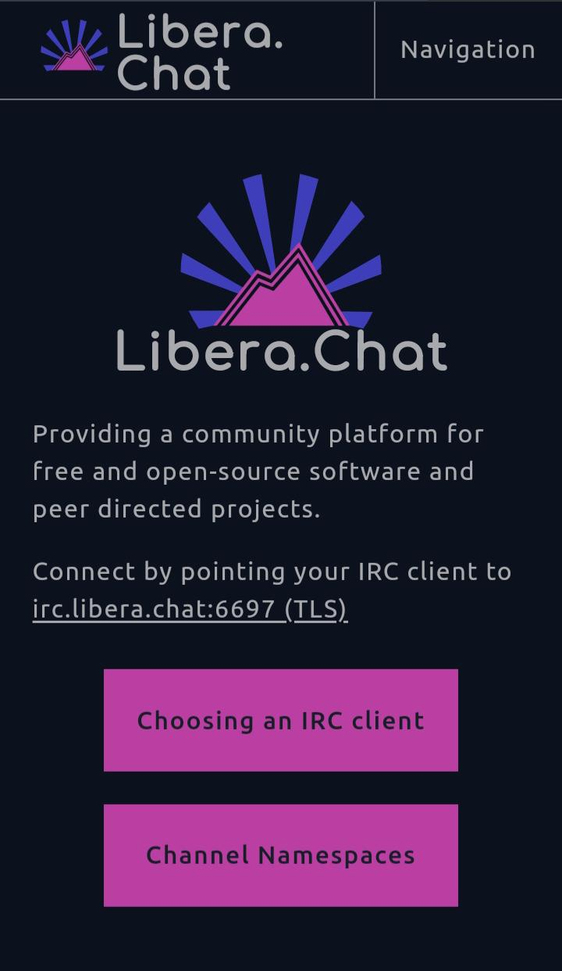

Slide 32
Diving In
Migrate from your previous system Learn how Front Matter works Put information on your site with Variables Customize the Permalinks your posts are generated with Use the built-in Liquid Extensions to make your life easier Use custom Plugins to generate content specific to your site Watch video tutorials from Giraffe Academy

Slide 33
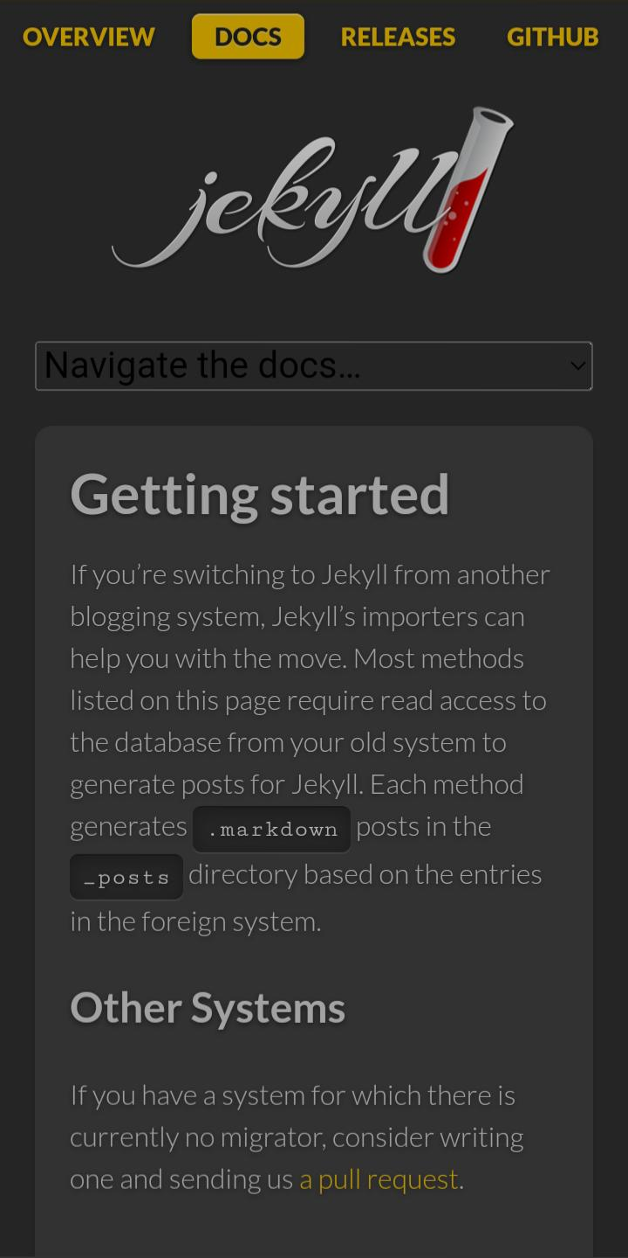

Slide 34
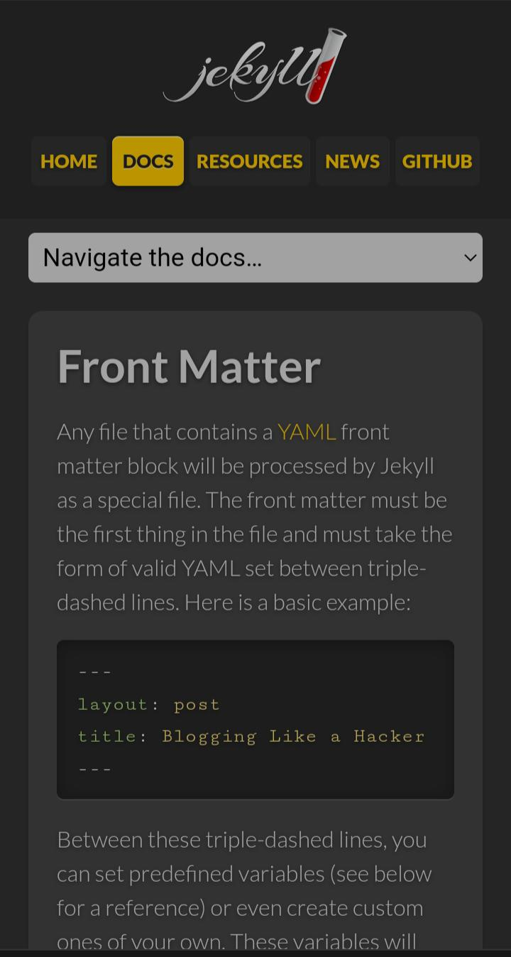

Slide 35
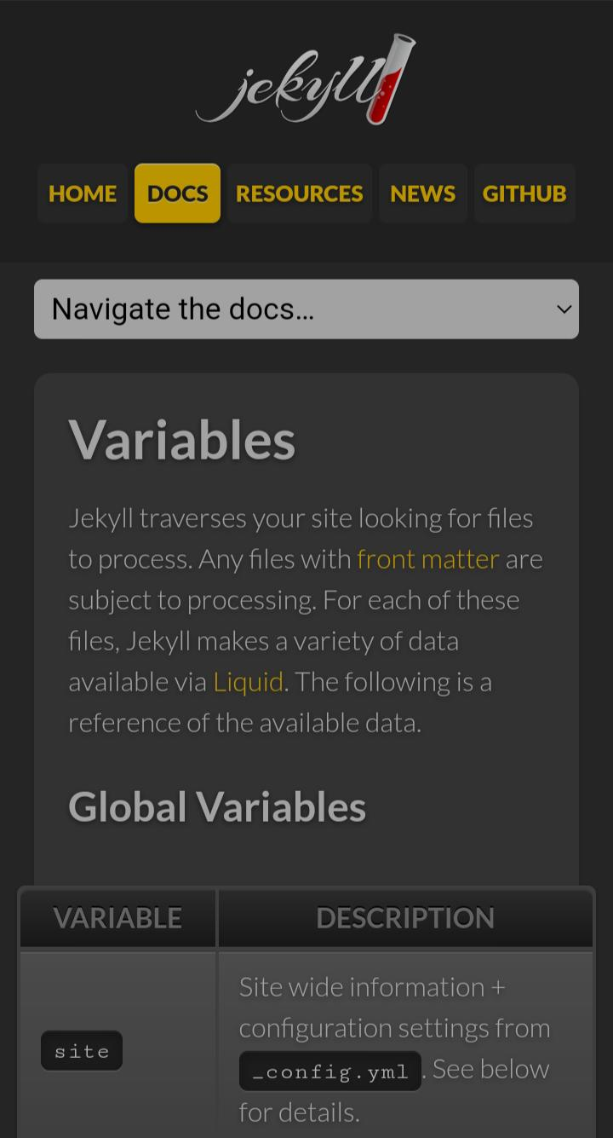

Slide 36
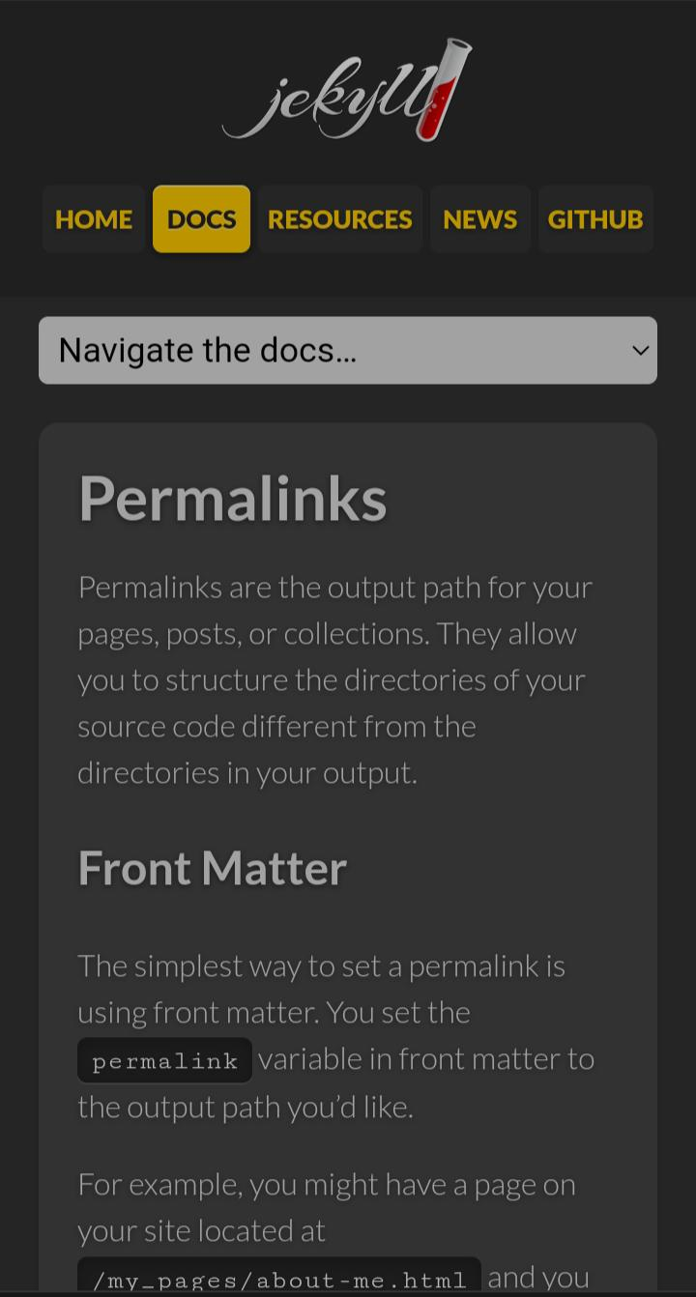

Slide 37
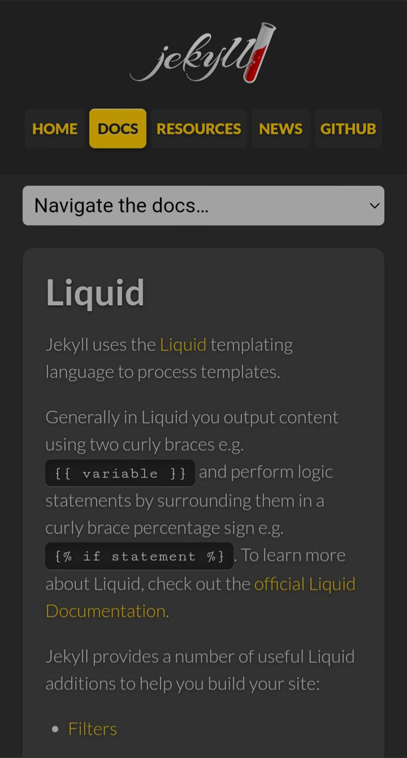

Slide 38
Sponsors
Support this project by becoming a sponsor. Your logo will show up in this README with a link to your website. Become a sponsor!

Slide 39



Slide 40
Thank you

